Slide 1




Orientation Session for First-Time Attendees
by Jill R. Sommer and Amanda Ennis
Photos by Jeff Sanfacon, ATA and
Jill R. Sommer
Notes:
When you speak in public, you should aim for a style that's natural for you. (This will help calm your nerves, for one thing). So remember, the “comments” suggestions in the basic PowerPoint are just one option, to get you started. Replace them with examples from your own practice, to weave in our industry’s “best practice” message with a reminder that you practice what you preach.
FIRST THINGS FIRST: THE TITLE!
CRAFT A TITLE TO FIT YOUR AUDIENCE.
PERHAPS SIMPLY PERSONALIZE THE ONE ABOVE. FOR EXAMPLE:
“Putting the power of language to work for small businesses in [NAME OF YOUR TOWN]” or “Putting the power of language to work in patent litigation” or “Putting the power of language to work in community healthcare”.
HERE ARE SOME SAMPLE COMMENTS FOR YOUR INTRO:
I’m a professional translator, which is one of the most exciting jobs around.
Translators often work in the shadows, but the work we do sets the stage for transactions in virtually every sector of the economy.
Today I want to tell about how I work, and how what I do can make your business more successful.

Slide 2

Must-Haves for the Conference
Business cards
Résumé uploaded to the new mobile app
Comfortable shoes
Energy
An elevator speech (approx. 30-60 second pitch about you and your services – see http://tinyurl.com/3ktc5a4)

Slide 3

The ATA 53rd Annual Conference Mobile App
ATA has designed an app to put the entire conference at your fingertips –
before, during and after the conference.

Slide 4
The ATA 53rd Annual Conference Mobile App
It is available on any smartphone – and can also be viewed on your laptop‘s browser.
Only registered attendees will be able to access this app.
Notes:
4

Slide 5
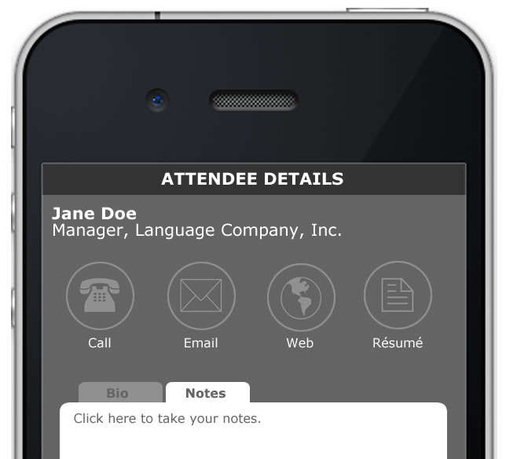
The ATA 53rd Annual Conference Mobile App
Upload your résumé to share it with attendees and exhibitors
Browse the schedule, abstracts and bios
Receive schedule updates and alerts as they happen

Slide 6
The ATA 53rd Annual Conference Mobile App
Use interactive floor plans to locate exhibitor/ sponsor booths and visit their websites
Connect with other attendees to arrange meetings, lunches, coffee klatsches, etc.

Slide 7
The ATA 53rd Annual Conference Mobile App
Find places to eat or visit and view contact info and map location
Check in with Facebook, Twitter or LinkedIn all within the app

Slide 8
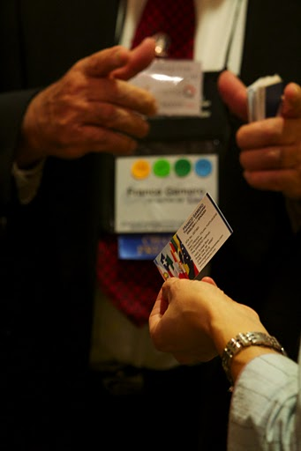
Anatomy of a Name Badge

Slide 9
Anatomy of a Name Badge
First time attendees get a pink ribbon to wear at the bottom of their ID tag
Carry business cards in your name badge – and jot down notes on how you met them on the back of the cards
Separate pockets to keep your business cards separate from the ones you collect

Slide 10
Name badges and bag
Mark your bag with a business card, ribbon or unique identifier
Colored dots indicate languages. Good ice breaker
Be sure to get language dots from the Hospitality Desk
Notes:
10

Slide 11
Hospitality Desk
The Hospitality Desk will be staffed by the Association of Translators and Interpreters in the San Diego Area (ATISDA)
Visit their blog for tips at http://atasandiego2012.wordpress.com

Slide 12
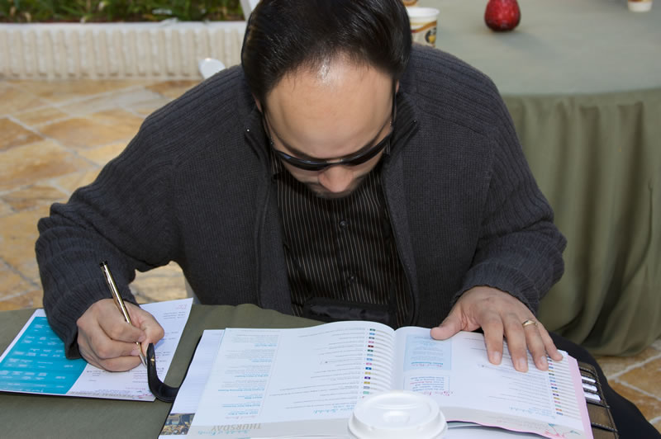
Plan your day
... but be prepared to be flexible

Slide 13
Understanding the Program
Schedule at a glance
Hour by hour calendar
Complete description of sessions
Room locator and hotel map
Personal conference planner

Slide 14
Understanding the Program
Final program is in the totebag you receive at when you check in at the Onsite Registration Desk
The final program will also be on the new Mobile App
Cancellations and changes will be announced through the new Mobile App alerts

Slide 15
Understanding the Program
Even if you have printed the online program on the ATA website and have taken notes on the plane, you will need to read the final program that was given to you when you registered

Slide 16
Session Tips
If you are fairly new to the profession, plan to attend as many sessions as you can take, particularly the ones focusing on the relationship with clients.
The Independent Contractor sessions are "must-sees" if you are new to the industry (and even if you aren't).

Slide 17
Session Tips
Aim for a mix of sessions: some that address your current work, some that touch on areas that you would like to get into.
Attend a session you may not normally attend.

Slide 18
Session Tips
When trying to decide whether to attend the presentation, and the short description is insufficient to make up your mind, check the conference Proceedings DVD.
If you suspect that a session may not be what you hope, try to sit in the back and leave as quietly as possible if necessary.

Slide 19
Session Tips
Plan to attend at least 3 sessions – if one session is outstanding I consider it to be a successful conference
Try to attend one or more of the Tools Tutorials

Slide 20
Session Tips
If you are upset that your language or field does not have many sessions being offered, please submit a session proposal for next year.
Sessions are planned based on the proposals that are submitted.

Slide 21
Tool Tutorials
Tool vendors provide free, in-depth tutorials (not sales pitches) for beginning and intermediate users of their tools.
The tutorials are hands-on workshops and/or lecture-style presentations.

Slide 22
Tool Tutorials
Some people attend the conference purely for the tool tutorials.
Visit www.atanet.org/conf/2012/tools.htm for more details

Slide 23
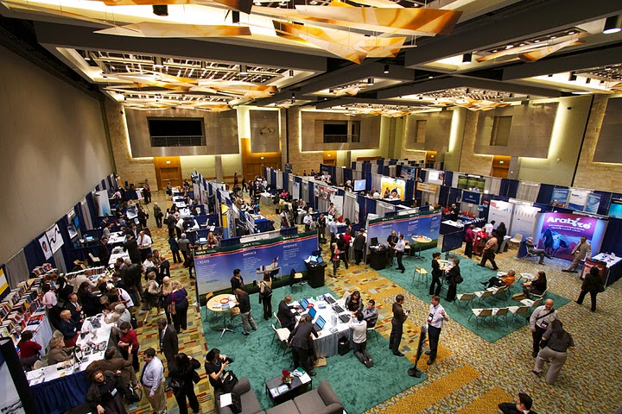
The Exhibit Hall

Slide 24
The Exhibit Hall
Plan to go through the Exhibit Hall at least twice - there are quite a few exhibitors and some booths are unattended at times.
The ATA Exhibit Hall has a very pleasant atmosphere. It is quiet, friendly, and there is often coffee, free pens, and chocolate.
No chair massages this year.

Slide 25
The Exhibit Hall
Tool vendors
Dictionaries, books and reference materials
Insurance companies
Translation programs and universities
Clients and translation agencies

Slide 26
Networking
Networking is best when you are friendly, useful, and genuine.
The goal of networking should be to help other people and put their needs first.
Ask questions instead of just talking about yourself.
I highly recommend reading 24 networking tips that actually work and following their advice.

Slide 27
Networking
Word of mouth is the best advertising.
Networking is not just about getting more work. It's also great to exchange ideas with colleagues.
Get your colored dots. Wear your first-time attendee ribbon. Smile, ask questions.
Don't assume we all know each other

Slide 28
Networking
The official NW session, Speed Networking, is Thursday night from 6:00-7:00 p.m.
Get your 30-second pitch ready, grab your business cards and network
Prepare a few questions to ask each person
Set yourself a goal to talk to 5 people there and if you like it keep going

Slide 29
Networking
Breakfast is a good time to network
-> Free food
-> No one is tired yet
-> Nobody is running between sessions
The Translation Company Division, for example, has their reception at breakfast on Friday
Opportunity to talk with the Board Members

Slide 30
Networking
Best way to network is to get involved – in your local chapter, in your division, on division listservs, present at conferences, write an article for The ATA Chronicle, volunteer to edit division/chapter newsletter, etc.

Slide 31
Certification Exam
You cannot register for the exam at the Conference – register beforehand and take the practice tests
Two written exam sessions and one keyboarded exam session
Spend some time preparing yourself for the exam

Slide 32
Certification Exam
Attend the session on Preparing to Take the ATA Certification Exam: Q&A, Thursday, 3:45-5:00 p.m. in Sapphire L and ask any questions that you have.
Get some rest the night before. Bring food/water. Bring a sweater/coat. Unwrap crinkly wrapping beforehand.

Slide 33
Opening Session & ATA Election
Consider becoming an Active Member for next year through Peer Review (http://tinyurl.com/8n4cjda)

Slide 34
Special Events on Thursday
Special Series: The Future of T&I on Thursday from 11 a.m. to noon.
Eight people representing different views on the translation and interpreting industry will give "lightning" presentations
It then continues with "Comment Capture" to gather your thoughts and opinions throughout the conference, and then ends with "The Debate" for the final word on important issues."

Slide 35
Non-Session Events
List of ATA Events in program – most include a registration fee (division receptions, the tennis tournament or the certification examination)
Stretch, Move & Breathe every morning from 6:30-7:15
Literary Division's After Hours Cafe Friday night
Discuss business at the Business Practices Happy Hour
The Conference Dance Saturday night
Private receptions by translation companies and vendors

Slide 36
Message Board
There is a message board with notepads and thumbtacks near the Registration Desk. Check it often and feel free to use it.
People leave messages for fellow attendees.
Look for roommates for the last night (if their roommate has left early).
Vendors and clients post job listings.

Slide 37
ATA eConference
There are often scheduling conflicts with several sessions being offered at the same time.
One way to deal with this is to buy the online eConference.
The special price of $99 is only offered to those who pre-order when registering for the conference – and an extra DVD recording for $30 (http://www.atanet.org/conf/2012/dvdrom.htm)

Slide 38
Safety tips
When people are at a conference they tend to act as if they are in a bubble and nothing bad can happen. This is not the case. One should behave at a conference in the same way as one would in a foreign country or even at home – with some caution.
The fact is that hotels in general are public locations, and anyone can come in off the street and blend into the crowd.

Slide 39
Safety tips
Do not leave your laptop or valuables unattended!!!!
Consider installing encryption on your laptop. The Language Technology Division recommends TrueCrypt to protect your data if your laptop is lost or stolen. (http://languagetechdivision.org/?s=truecrypt&x=0&y=0)

Slide 40
Miscellaneous Tips
Be sure to fill out feedback forms on sessions. Prizes are also given out daily, and one of you could win a free conference registration for next year.
Carry as little as possible. Wear comfortable shoes and clothes.
When leaving a place in a hurry, check what you are grabbing!
Take your name badge off when you leave the hotel.

Slide 41
Miscellaneous Tips
This is not a language practice event. When conversing with others outside your division, pick the Best Common Language.
Don’t attend too many sessions – give yourself some down time to socialize or be a tourist
Make sure you drink plenty of liquids
Take lots of business cards with you everywhere

Slide 42
Miscellaneous Tips
Some attendees stay at other hotels for cost reasons. Staying in the conference hotel is more practical and increases your networking opportunities. It's also nice to run up to the room for a quick break. One solution is to locate a potential roommate through ATA's Roommate Referral Blog (http://www.ataroommates-sandiego.blogspot.com/).

Slide 43
Miscellaneous Tips
Except for a very few invited speakers who are not members of the ATA, all the people you will see making presentations and moderating forums are volunteers. If you like what you hear or see, please tell them. If you don't, be constructive with your comments – not cruel.

Slide 44
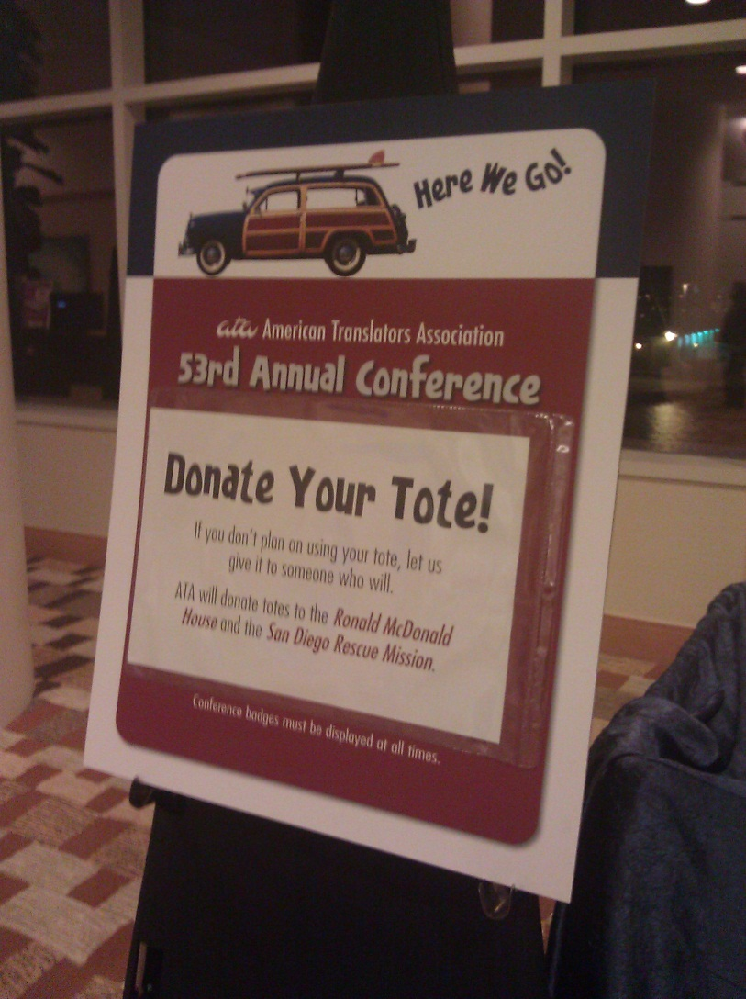
Miscellaneous Tips

Slide 45
Miscellaneous Tips
Do not completely wear yourself out so that you do not enjoy the sessions – pace yourself to better enjoy the entire conference experience.
Enjoy yourself – this is the highlight of the year for many

Slide 46
Thank you!
Any questions?

